Slide 1
12기 정규세션
ToBig’s 11기 임채빈
Convolutional Neural Networks

Slide 2
Unit 01 ㅣ intro : Applications of CNN
Unit 02 ㅣ CNN
Contents
Unit 03 ㅣ Convolution Layer
Unit 04 ㅣ Sub-sampling
Unit 05 ㅣ Summary

Slide 3

Unit 01 ㅣ intro : Applications of cnn
Applications of cnn

Slide 4
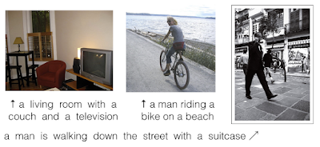
Unit 01 ㅣ intro : Applications of cnn
Image Caption Generation

Slide 5
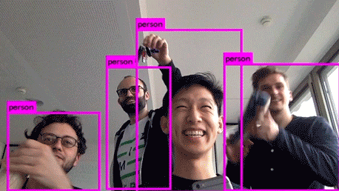
Unit 01 ㅣ intro : Applications of cnn
Real Time Object Detection

Slide 6
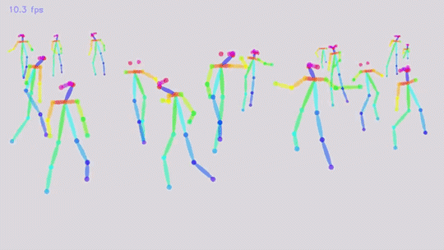
Unit 01 ㅣ intro : Applications of cnn
Real Time Pose Estimation

Slide 7

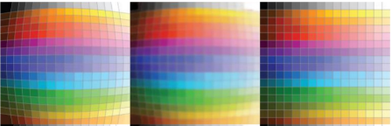

Unit 01 ㅣ intro : Applications of cnn
GAN

Slide 8

Unit 02 ㅣ Layers in CNN
Convolution Layer + Subsampling Layer + Fully Connected Layer
Feature extraction : Convolution Layer + Pooling Layer
Classification : Fully Connected Layer

Slide 9
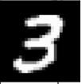
Unit 02 ㅣ Layers in CNN
Conventional Neural Network

Slide 10
Unit 02 ㅣ Layers in CNN
Conventional Neural Network
Image pixel (5x5)

Slide 11
Unit 02 ㅣ Layers in CNN
Conventional Neural Network
Flatten (1 x 25)

Slide 12
Unit 02 ㅣ Layers in CNN
Conventional Neural Network
FC + Activation function

Slide 13
Unit 02 ㅣ Layers in CNN
Conventional Neural Network
FC+ Classifier

Slide 14
Unit 02 ㅣ Layers in CNN
Convolutional Neural Network
Image pixel (5x5)

Slide 15
Unit 02 ㅣ Layers in CNN
Convolutional Neural Network
Receptive field : 출력 레이어의 뉴런 하나에 영향을 미치는 입력 뉴련들의 공간
Receptive field
Conv + Activation function

Slide 16
Unit 02 ㅣ Layers in CNN
Convolutional Neural Network
Conv + Activation function

Slide 17
Unit 02 ㅣ Layers in CNN
Convolutional Neural Network
Conv + Activation function

Slide 18
Unit 02 ㅣ Layers in CNN
Convolutional Neural Network
Conv + Activation function

Slide 19
Unit 02 ㅣ Layers in CNN
Convolutional Neural Network
Conv + Activation function

Slide 20
Unit 02 ㅣ Layers in CNN
Convolutional Neural Network
Conv + Activation function

Slide 21
Unit 02 ㅣ Layers in CNN
Convolutional Neural Network
pooling

Slide 22
Unit 02 ㅣ Layers in CNN
Convolutional Neural Network
pooling

Slide 23
Unit 02 ㅣ Layers in CNN
Convolutional Neural Network
pooling

Slide 24
Unit 02 ㅣ Layers in CNN
Convolutional Neural Network
pooling

Slide 25
Unit 02 ㅣ Layers in CNN
Convolutional Neural Network
Flatten

Slide 26
Unit 02 ㅣ Layers in CNN
Convolutional Neural Network
FC + Classifier

Slide 27
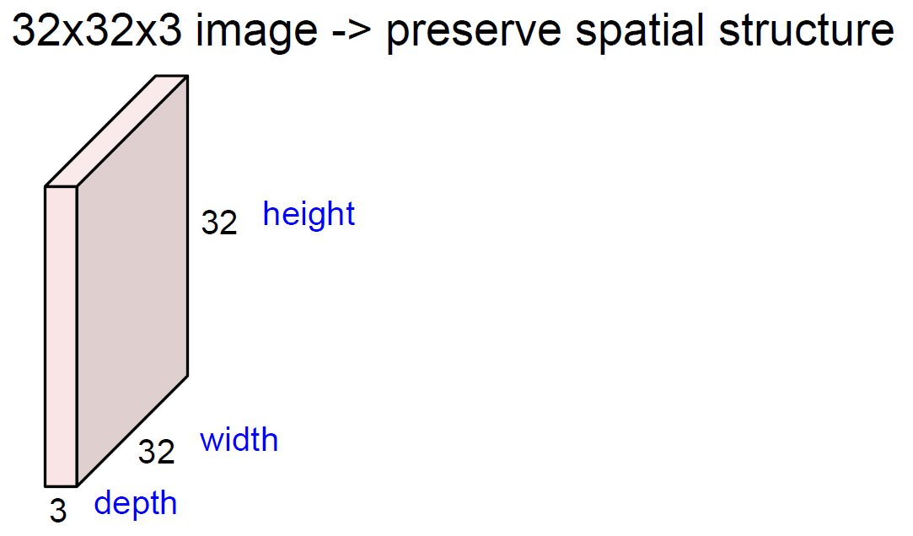
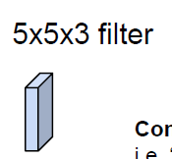
Unit 03 ㅣ Convolution Layer
Convolution
(Shared Weight)
Image와 filter의 channel은 항상 같다.
Ex) RGB = 3 channel, grayscale = 1channel
(Channel)

Slide 28
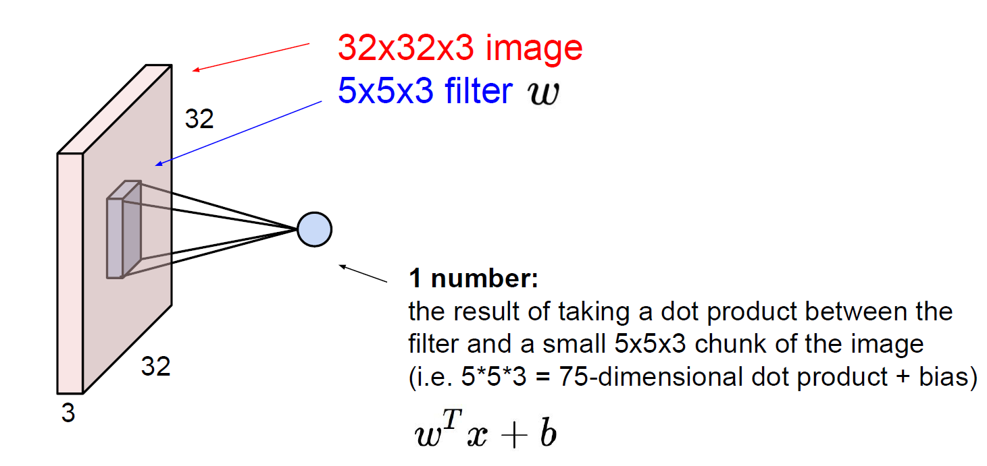
Unit 03 ㅣ Convolution Layer
Convolution

Slide 29
Unit 03 ㅣ Convolution Layer
Convolution
2
3
0
1
3
2
1
0
2
0
0
0
0
1
0
1
0
2
0
1
0
3
2
2
2
2
1
0
1
2
2
2
2
1
0
1
0
2
2
2
2
1
0
2
1
1
1
0
0
1
0
1
0
2
1
1
1
0
0
1
0
0
3
2
2
1
1
1
0
3
2
2
0
0
2
3
0
1
0
0
0
0
3
2
2
0
0
2
2
0
0
0
2
0
0
0
0
2
0
0
2
2
0
0
2
0
1
0
1
0
1
0
2
0
3
0
0
2
0
0
0
0
0
0
0
0
0
0
2
2
0
0
2
2
2
2
0
0
0
1
0
0
2
2
2
2
1
2
0
0
2
2
2
0
3
2
3
2
1
0
0
1
0
1
0
0
0
0
0
2
0
2
0
0
Image 7x7x3
filter 3x3x3

Slide 30
Unit 03 ㅣ Convolution Layer
Convolution
2
3
0
1
3
2
1
0
2
2
2
2
1
0
1
2
1
1
1
0
0
1
0
1
3
2
2
0
0
2
3
0
1
0
2
0
0
0
0
2
0
1
0
1
0
0
0
2
2
2
2
1
3
2
3
2
1
0
Input Volumn ( 7x7 )
Filter ( 3 x 3)
Convolved Feature Volumn ( 5 x 5)

Slide 31
Unit 03 ㅣ Convolution Layer
Convolution
2
3
0
1
3
2
1
Dot Product
6
0
2
2
2
2
1
0
1
2
1
1
1
0
0
1
0
1
3
2
2
0
0
2
3
0
1
0
2
0
0
0
0
2
0
1
0
1
0
0
0
2
2
2
2
1
3
2
3
2
1
0
Input Volumn ( 7x7 )
Filter ( 3 x 3)
Convolved Feature Volumn ( 5 x 5)

Slide 32
Unit 03 ㅣ Convolution Layer
Convolution
2
3
0
1
3
2
1
Dot Product
6
9
0
2
2
2
2
1
0
1
2
1
1
1
0
0
1
0
1
3
2
2
0
0
2
3
0
1
0
2
0
0
0
0
2
0
1
0
1
0
0
0
2
2
2
2
1
3
2
3
2
1
0
Input Volumn ( 7x7 )
Filter ( 3 x 3)
Convolved Feature Volumn ( 5 x 5)

Slide 33
Unit 03 ㅣ Convolution Layer
Convolution
2
3
0
1
3
2
1
Dot Product
6
9
7
0
2
2
2
2
1
0
1
2
1
1
1
0
0
1
0
1
3
2
2
0
0
2
3
0
1
0
2
0
0
0
0
2
0
1
0
1
0
0
0
2
2
2
2
1
3
2
3
2
1
0
Input Volumn ( 7x7 )
Filter ( 3 x 3)
Convolved Feature Volumn ( 5 x 5)

Slide 34
Unit 03 ㅣ Convolution Layer
Convolution
2
3
0
1
3
2
1
6
9
7
6
6
0
2
2
2
2
1
0
9
7
7
6
5
1
2
1
1
1
0
0
1
0
1
6
5
2
3
3
3
2
2
0
0
2
3
0
1
0
5
4
4
6
9
2
0
0
0
0
2
0
1
0
1
5
6
6
8
4
0
0
0
2
2
2
2
1
3
2
3
2
1
0
Input Volumn ( 7x7 )
Filter ( 3 x 3)
Convolved Feature Volumn ( 5 x 5)

Slide 35
Unit 03 ㅣ Convolution Layer
Convolution
0
2
0
0
0
0
1
0
2
0
0
0
1
2
2
2
2
1
0
1
2
2
2
2
0
2
1
1
1
0
0
1
0
0
0
2
1
1
1
3
2
2
0
0
2
2
0
0
0
3
2
2
0
0
2
0
3
0
0
2
0
0
0
0
2
0
3
0
0
1
0
0
2
2
2
2
0
1
0
1
0
0
0
Input Volumn ( 7x7 )
Filter ( 3 x 3)
Convolved Feature Volumn ( 5 x 5)

Slide 36
Unit 03 ㅣ Convolution Layer
Convolution
1
0
2
0
1
0
3
2
2
2
2
1
0
2
2
2
2
1
0
2
1
1
1
0
2
2
1
1
1
0
3
0
0
0
2
2
0
0
2
0
2
2
0
0
2
0
0
1
0
0
0
0
0
2
0
0
0
0
0
2
2
0
0
0
0
0
2
2
2
2
0
0
2
2
2
0
0
0
2
0
2
0
0
Input Volumn ( 7x7 )
Filter ( 3 x 3)
Convolved Feature Volumn ( 5 x 5)

Slide 37
Unit 03 ㅣ Convolution Layer
Convolution
New feature map
6
9
7
6
6
0
2
0
0
0
2
2
2
2
1
8
13
9
8
7
9
7
7
6
5
1
2
2
2
2
2
1
1
1
0
12
10
10
9
7
6
5
2
3
3
0
2
1
1
1
2
2
0
0
2
8
9
3
4
6
5
4
4
6
9
3
2
2
0
0
0
0
0
0
2
8
6
6
6
11
5
6
6
8
4
2
0
3
0
0
0
0
2
2
2
7
6
11
10
6

Slide 38
Unit 03 ㅣ Convolution Layer
Convolution
2
3
0
1
3
2
1
0
2
0
0
0
0
1
New feature map
0
1
0
2
0
1
0
3
2
2
2
2
1
0
1
2
2
2
2
1
0
8
13
9
8
7
1
0
2
2
2
2
1
0
2
1
1
1
0
0
1
0
1
0
2
1
1
1
0
0
1
0
0
12
10
10
9
7
3
2
2
1
1
1
0
3
2
2
0
0
2
3
0
1
0
0
0
0
3
2
2
0
0
2
2
0
0
0
8
9
3
4
6
2
0
0
0
0
2
0
Dot Product
0
2
2
0
0
2
0
1
0
1
0
1
0
2
0
3
0
0
2
0
0
0
0
8
6
6
6
11
0
0
0
0
0
0
2
2
0
0
2
2
2
2
0
0
0
1
0
0
2
2
2
2
7
6
11
10
6
1
2
0
0
2
2
2
0
3
2
3
2
1
0
0
1
0
1
0
0
0
0
0
2
0
2
0
0
Image 7x7x3
filter 3x3x3
Feature map 5x5x1

Slide 39
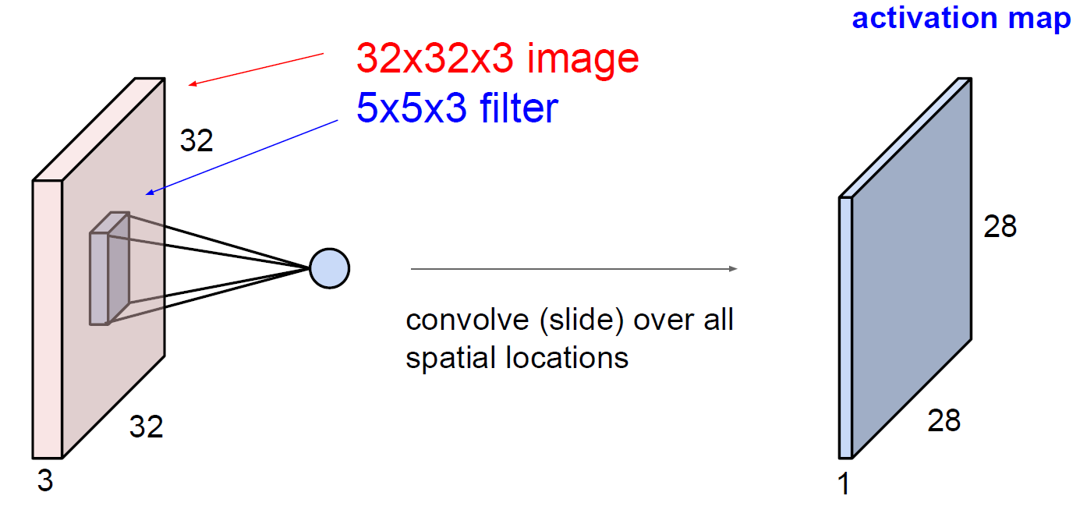
Unit 03 ㅣ Convolution Layer
Convolution

Slide 40
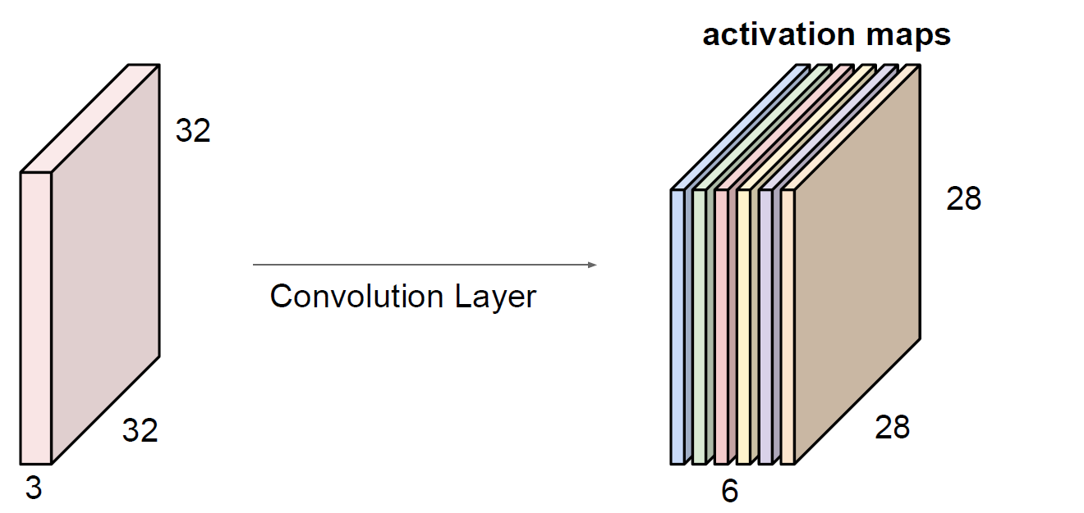
Unit 03 ㅣ Convolution Layer
Convolution
Filter 수가 6개라면 6개의 새로운 feature map이 생성됨. (hyper parameter)
6개의 feature map을 stack up하여 28x28x6의 새로운 데이터 생성
6개
Parameter 개수?
(weight + bias)

Slide 41
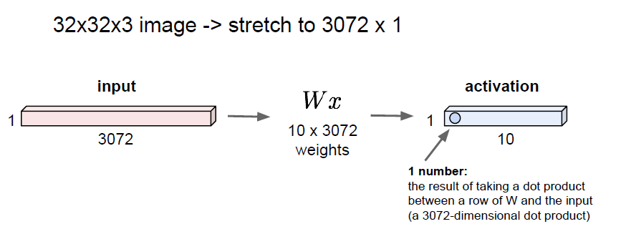
Unit 03 ㅣ Convolution Layer
Convolution
각각의 pixel을 하나의 channel로 flatten 후 1x1x3072 filter 10개를 사용
FC?
Parameter 개수?
(weight + bias)

Slide 42
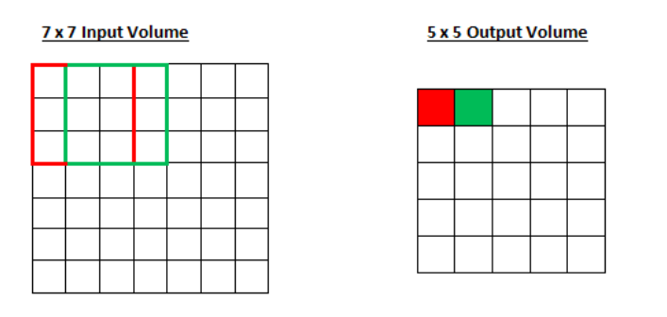
Unit 03 ㅣ Convolution Layer
Stride
Filter가 이동하는 거리
Stride = 1

Slide 43
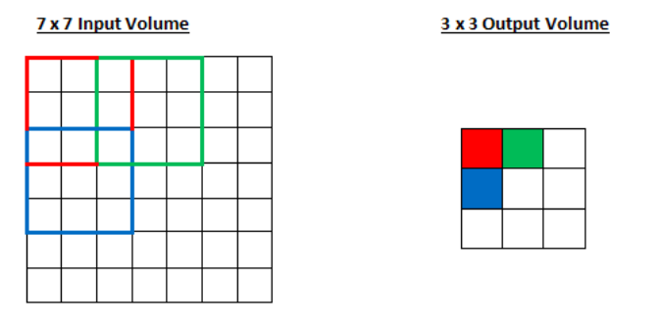
Unit 03 ㅣ Convolution Layer
Stride
Filter가 이동하는 거리
Stride = 2

Slide 44
Unit 03 ㅣ Convolution Layer
Stride
Filter가 이동하는 거리
Stride = 2

Slide 45
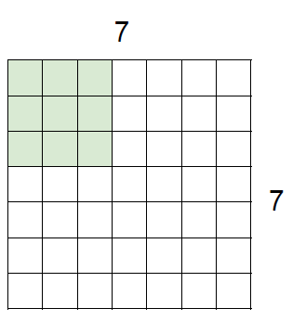
Unit 03 ㅣ Convolution Layer
Stride
Filter가 이동하는 거리
Stride = 3?

Slide 46
Unit 03 ㅣ Convolution Layer
Stride
Filter가 이동하는 거리
Output의 volume이 integer가 되도록 stride 설정
doesn’t fit!
Stride = 3?

Slide 47
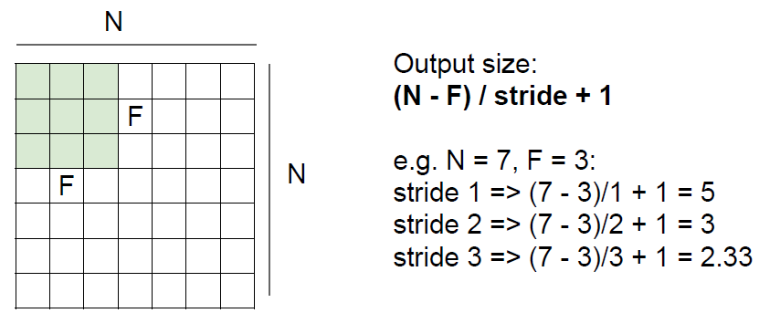
Unit 03 ㅣ Convolution Layer
Stride
Filter가 이동하는 거리
Output의 volume이 integer가 되도록 stride 설정
Fraction!

Slide 48
Unit 03 ㅣ Convolution Layer
Stride
Filter가 이동하는 거리
Output의 volume이 integer가 되도록 stride 설정
Fraction!

Slide 49
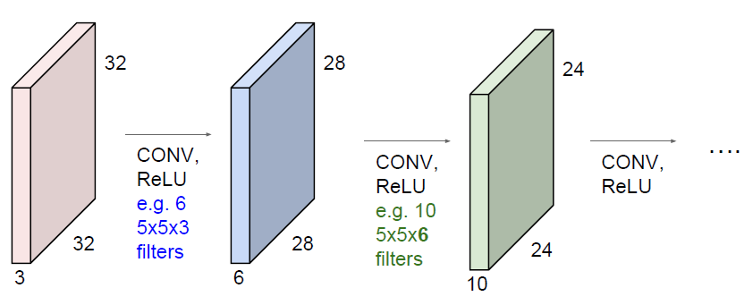
Unit 03 ㅣ Convolution Layer
Padding
Convolution layer 층이 깊어질 수록 data의 size가 줄어든다.
Data size가 너무 빠르게 줄어들면 잘 작동하지 않음!
32 -> 28 -> 24 -> 20 -> 16 -> …

Slide 50
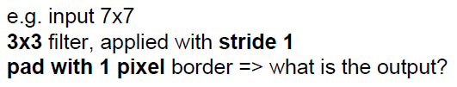
Unit 03 ㅣ Convolution Layer
Padding
데이터 테두리에 zero-padding을 더해 크기 손실 방지
0
0
0
0
0
0
0
0
0
0
0
0
0
0
0
0
0
0
0
0
0
0
0
0
0
0
0
0
0
0
0
0

Slide 51
Unit 03 ㅣ Convolution Layer
Padding
데이터 테두리에 zero-padding을 더해 크기 손실 방지
0
0
0
0
0
0
0
0
0
0
0
0
0
0
0
(N + P - F) / stride + 1
= (7 + 2 - 3) / 1 + 1
= 7
0
0
Input size = Output size
0
0
0
0
0
0
0
0
0
0
0
0
0
0
0

Slide 52
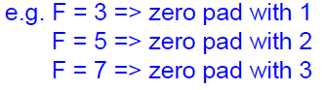
Unit 03 ㅣ Convolution Layer
Padding
데이터 테두리에 zero-padding을 더해 크기 손실 방지
0
0
0
0
0
0
0
0
0
0
0
0
0
0
0
(N + P - F) / stride + 1
= (7 + 2 - 3) / 1 + 1
= 7
0
0
Input size = Output size
0
0
0
0
0
0
0
0
0
0
0
0
0
0
0

Slide 53
Unit 03 ㅣ Convolution Layer
Padding
데이터 테두리에 zero-padding을 더해 크기 손실 방지
0
0
0
0
0
0
0
0
0
0
0
0
0
0
0
(N + P - F) / stride + 1
= (7 + 2 - 3) / 1 + 1
= 7
0
0
Input size = Output size
0
0
0
0
0
0
0
0
0
0
0
0
0
0
0

Slide 54
Unit 03 ㅣ Convolution Layer
Padding
데이터 테두리에 zero-padding을 더해 크기 손실 방지
0
0
0
0
0
0
0
0
0
0
0
0
0
0
0
(N + P - F) / stride + 1
= (7 + 2 - 3) / 1 + 1
= 7
0
0
Input size = Output size
0
0
0
0
0
0
0
0
0
0
0
0
0
0
0

Slide 55
Unit 03 ㅣ Convolution Layer
Example
Input volume: 32x32x3
10 5x5 filters with stride 1, pad 2
1. Output volume size: ?
2. Number of parameters in this layer : ?

Slide 56

Unit 04 ㅣ Sub-Sampling
Sub Sampling
이미지의 특성은 유지
사이즈를 줄여 관리하기 쉽게 만듬
각 feature map마다 독립적으로 작용
But 기기의 성능 향상으로
사이즈를 줄일 필요가 적어지면서
성능을 위해 잘 사용하지 않는 추세

Slide 57
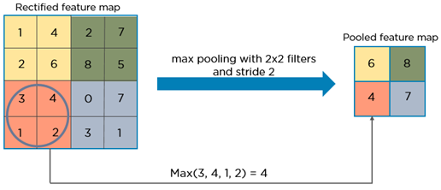
Unit 04 ㅣ Sub-Sampling
Sub Sampling
Max pooling
Filter size와 stride 존재

Slide 58

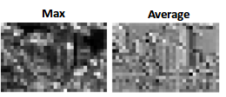
Unit 04 ㅣ Sub-Sampling
Max pooling vs Average pooling
Max pooling
해당 window의 max값을 추출
Average pooling
해당 window의 평균 값 추출 (smoothing 됨)

Slide 59
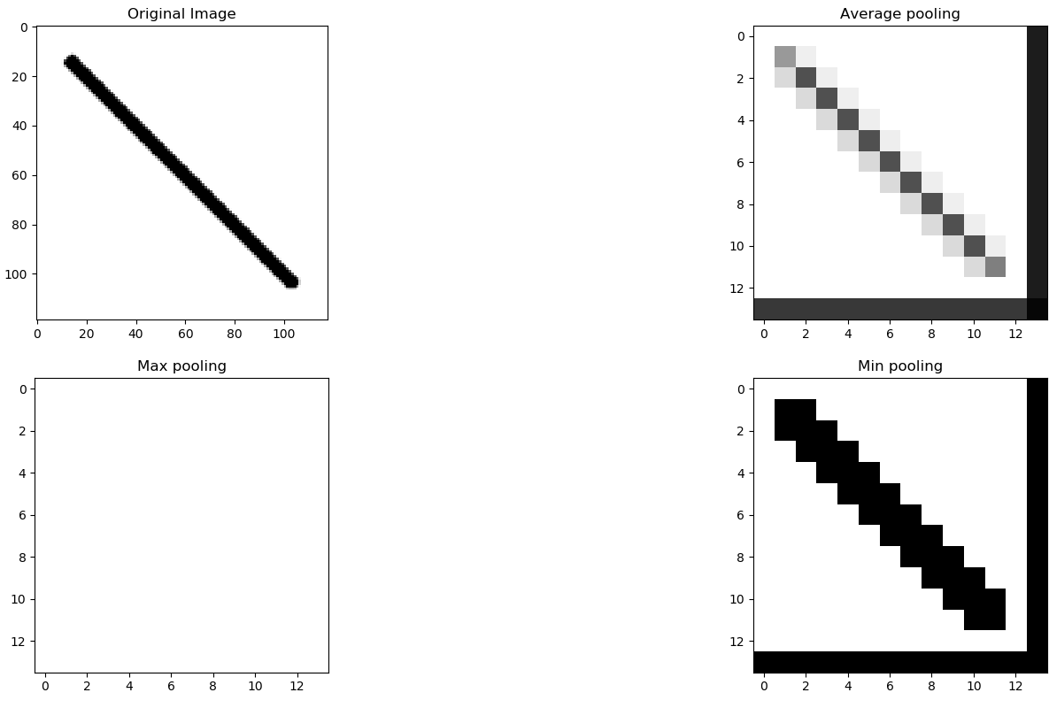
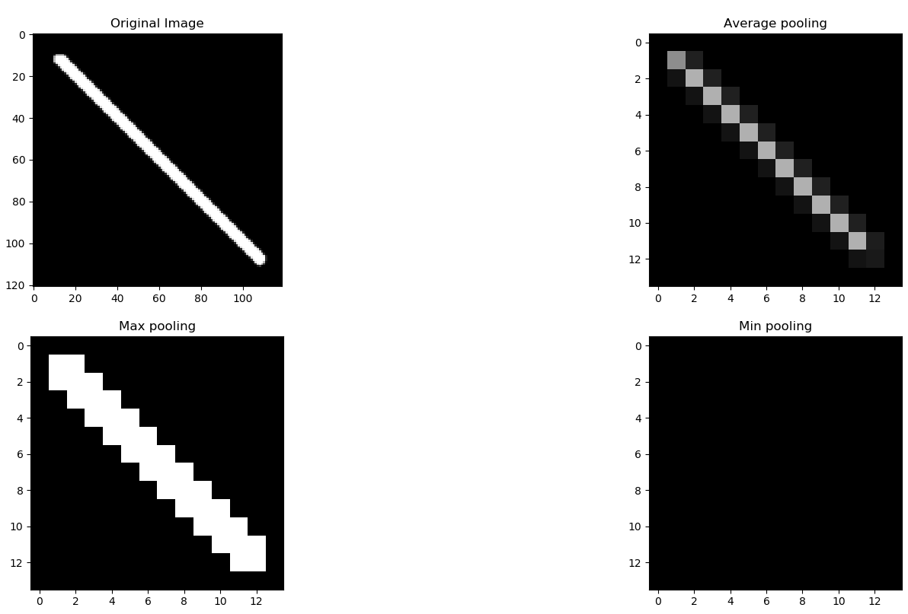
Unit 04 ㅣ Sub-Sampling
Max pooling vs Average pooling
Most important features를 뽑는다는 관점에서 일반적으로 Max pooling을 사용

Slide 60
Unit 04 ㅣ Sub-Sampling
pretty much everything of 'CNN’ (AlexNet)

Slide 61
Unit 05 ㅣ Summary
Convolution Layer + Subsampling Layer + Fully Connected Layer
Feature extraction : Convolution Layer + Pooling Layer
Classification : Fully Connected Layer

Slide 62
Unit 02 ㅣ Layers in CNN
Convolutional Neural Network
Local connectivity(receptive field)
지역적으로 뉴런을 연결하여 다양한 local feature 추출 가능
Shared Weights and Biases (topology invariance)
Filter의 weight을 공유하여 parameter를 획기적으로 줄일 수 있다.
찾고자 하는 특징이 이미지 어디에 위치해도 알 수 있다.
Compositionality
저레벨 특징을 고레벨 특징으로 compose함
ex) 눈의 특징, 귀의 특징, 코의 특징 등등이 결합하여 사람의 얼굴의 특징으로 귀결

Slide 63
Unit 05 ㅣ Summary
용어 정리
Convolution(합성곱)
채널(Channel)
필터(Filter) = 커널(Kernel)
스트라이드(Stride)
패딩(Padding), zero-Padding
피처 맵(Feature Map) = 액티베이션 맵(Activation Map)
풀링(Pooling) 레이어
receptive field(수용공간)

Slide 64
Assignment
AlexNet
과제 1. assignment_1.ipynb 물음표 채우기
과제 2. AlexNet model 구현 (프레임워크 자유)
-모델 구현 후 summary로 전체 모델 구조 보이고 주석을 통해 간단한 설명
(각 프레임워크 별 summary 방법 구글링)

Slide 65
Q & A
들어주셔서 감사합니다.

Slide 66
Appendix
참고자료
# 10기 박성진님 강의
http://www.datamarket.kr/xe/index.php?mid=board_jPWY12&page=2&document_srl=52335
# Stanford cs231n 강의
http://cs231n.stanford.edu/syllabus.html
# towards data science
https://towardsdatascience.com/a-comprehensive-guide-to-convolutional-neural-networks-the-eli5-way-3bd2b1164a53
# 케라스 창시자에게 배우는 딥러닝
https://github.com/gilbutITbook/006975

